Slide 1

LECTURE 8: Software Testing
Instructor: Maria Striki
Presentation: Ivan Marsic, Maria Striki
Rutgers University

Slide 2
Topics
Overview of Software Testing
Test Coverage and Code Coverage
Practical Aspects of Unit Testing
Integration and System Testing

Slide 3
Overview of Software Testing
“Testing shows the presence, not the absence of bugs.” —Edsger W. Dijkstra
A fault, also called “defect” or “bug,” is an erroneous hardware or software element of a system that can cause the system to fail
Test-Driven Development (TDD)
    Every step in the development process must start with a plan of how to verify that the result meets a goal
    The developer should not create a software artifact (a system requirement, a UML diagram, or source code) unless they know how it will be tested
A test case is a particular choice of input data to be used in testing a program
A test is a finite collection of test cases

Slide 4
Why Testing is Hard
A key tradeoff of testing:
  testing as many potential cases as possible while keeping the economic costs limited
Our goal is to find faults as cheaply and quickly as possible.
  Ideally, we would design a single “right” test case to expose each fault and run it
In practice, we have to run many “unsuccessful” test cases that do not expose any faults

Slide 5
Logical Organization of Testing
( Not necessarily how it’s actually done! )
Component code
Unit test
Tested component
Component code
Unit test
Integration test
Integrated modules
System test
System in use
Ensures that all components work together
Component code
Unit test
Function test
Quality test
Acceptance test
Installation test
Ensure that each component works as specified
Verifies that functional requirements are satisfied
Verifies non-functional requirements
Customer verifies all requirements
Testing in user environment

Slide 6
Acceptance Tests - Examples
Input data
[ Recall Section 2.2: Requirements Engineering ]
Test with the valid key of a current tenant on his/her apartment (pass)
Test with the valid key of a current tenant on someone else’s apartment (fail)
Test with an invalid key on any apartment (fail)
Test with the key of a removed tenant on his/her previous apartment (fail)
Test with the valid key of a just-added tenant on his/ her apartment (pass)
Expected result

Slide 7
Example: Test Case for Use Case
[ Recall Section 2.3.3: Detailed Use Case Specification ]
Test-case Identifier: | TC-1
Use Case Tested: | UC-1, main success scenario, and UC-7
Pass/fail Criteria: | The test passes if the user enters a key that is contained in the database, with less than a maximum allowed number of unsuccessful attempts
Input Data: | Numeric keycode, door identifier
Test Procedure: |  | Expected Result:
Step 1. Type in an incorrect keycode and a valid door identifier |  | System beeps to indicate failure; records unsuccessful attempt in the database; prompts the user to try again
Step 2. Type in the correct keycode and door identifier |  | System flashes a green light to indicate success; records successful access in the database; disarms the lock device

Slide 8
Test Coverage
Test coverage measures the degree to which the specification or code of a software program has been exercised by tests
Code coverage measures the degree to which the source code of a program has been tested
Code coverage criteria include:
  equivalence testing
  boundary testing
  control-flow testing
  state-based testing

Slide 9
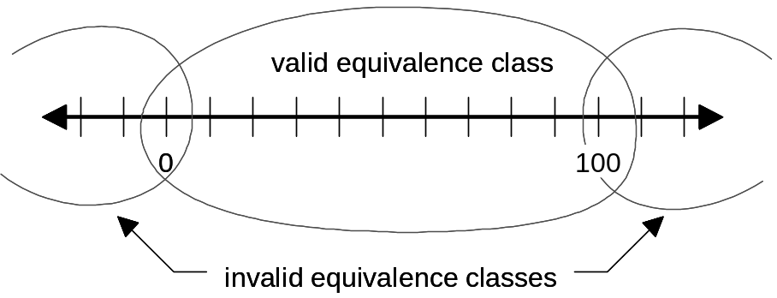
Code Coverage: Equivalence Testing
Equivalence testing is a black-box testing method that divides the space of all possible inputs into equivalence groups such that the program “behaves the same” on each group
Two steps:
    partitioning the values of input parameters into equivalence groups
    choosing the test input values
Equivalence classes:

Slide 10
Heuristics for
Finding Equivalence Classes
For an input parameter specified over a range of values, partition the value space into one valid and two invalid equivalence classes
For an input parameter specified with a single value, partition the value space into one valid and two invalid equivalence classes
For an input parameter specified with a set of values, partition the value space into one valid and one invalid equivalence class
For an input parameter specified as a Boolean value, partition the value space into one valid and one invalid equivalence class

Slide 11
Code Coverage: Boundary Testing
Boundary testing is a special case of equivalence testing that focuses on the boundary values of input parameters
  Based on the assumption that developers often overlook special cases at the boundary of equivalence classes
Selects elements from the “edges” of the equivalence class, or “outliers” such as
    zero, min/max values, empty set, empty string, and null
    confusion between > and >=
    etc.

Slide 12
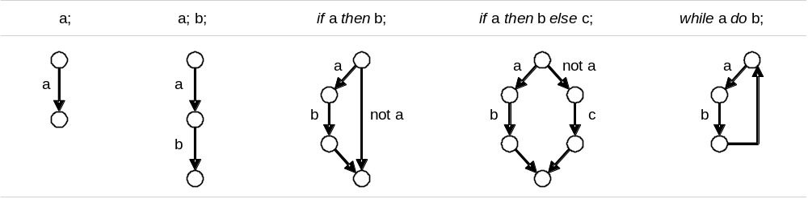
Code Coverage: Control-flow Testing
Statement coverage
    Each statement executed at least once by some test case
Edge coverage
    Every edge (branch) of the control flow is traversed at least once by some test case
Condition coverage
    Every condition takes TRUE and FALSE outcomes at least once in some test case
Path coverage
    Finds the number of distinct paths through the program to be traversed at least once
Constructing the control graph of a program for Edge Coverage:

Slide 13
Code Coverage: State-based Testing
State-based testing defines a set of abstract states that a software unit can take and tests the unit’s behavior by comparing its actual states to the expected states
  This approach has become popular with object-oriented systems
The state of an object is defined as a constraint on the values of object’s attributes
  Because the methods use the attributes in computing the object’s behavior, the behavior depends on the object state

Slide 14
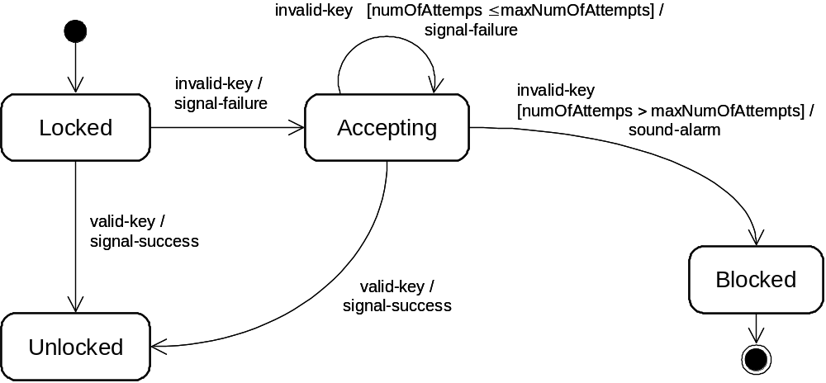
State-based Testing Example
event
guard condition
action
state
transition

Slide 15
State-based Testing Example
(counting attempts)

Slide 16
Controller State Diagram Elements
Four states
{ Locked, Unlocked, Accepting, Blocked }
Two events
{ valid-key, invalid-key }
Five valid transitions
{ Locked→Unlocked, Locked→Accepting, Accepting→Accepting, Accepting→Unlocked, Accepting→Blocked }

Slide 17
Ensure State Coverage Conditions
Cover all identified states at least once (each state is part of at least one test case)
Cover all valid transitions at least once
Trigger all invalid transitions at least once

Slide 18
Practical Aspects of Unit Testing
Mock objects:
  A test driver simulates the part of the system that invokes operations on the tested component
  A test stub simulates the components that are called by the tested component
The unit to be tested is also known as the fixture
Unit testing follows this cycle:
  Create the thing to be tested (fixture), the driver, and the stub(s)
  Have the test driver invoke an operation on the fixture
  Evaluate that the actual state equals expected state

Slide 19
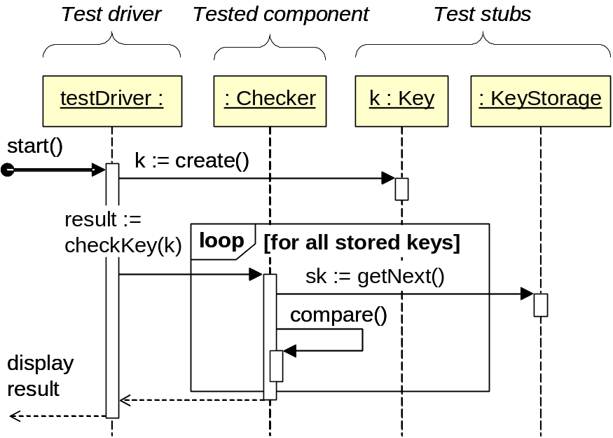
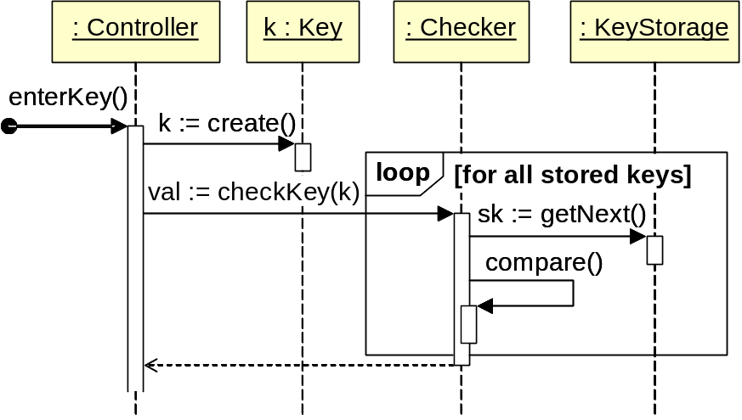
Testing the KeyChecker (Unlock Use Case)
(a)
(b)

Slide 20
xUnit / JUnit
Verification is usually done using the assert_*_() methods that define the expected state and raise errors if the actual state differs
http://www.junit.org/
Examples:
  assertTrue(4 == (2 * 2));
  assertEquals(expected, actual);
  assertNull(Object object);
  etc.

Slide 21
Example Test Case
Listing 2-1: Example test case for the Key Checker class.
public class CheckerTest { // test case to check that invalid key is rejected @Test public void checkKey_anyState_invalidKeyRejected() { // 1. set up Checker checker = new Checker( /* constructor params */ ); // 2. act Key invalidTestKey = new Key( /* setup with invalid code */ ); boolean result = checker.checkKey(invalidTestKey); // 3. verify assertEqual(result, false); } }

Slide 22
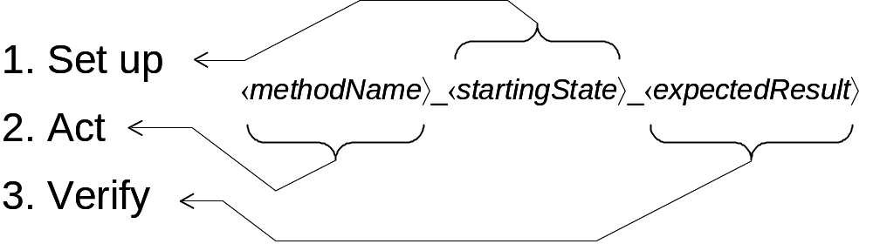
Test Case Method Naming
Example test case method name:
checkKey_anyState_invalidKeyRejected()

Slide 23
Another Test Case Example
Listing 2-2: Example test case for the Controller class.
public class ControllerTest { // test case to check that the state Blocked is visited @Test public void enterKey_accepting_toBlocked() { // 1. set up: bring the object to the starting state Controller cntrl = new Controller( /* constructor params */ ); // bring Controller to the Accepting state, just before it blocks Key invalidTestKey = new Key( /* setup with invalid code */ ); for (i=0; i < cntrl.getMaxNumOfAttempts(); i++) { cntrl.enterKey(invalidTestKey); } assertEqual( // check that the starting state is set up cntrl.getNumOfAttempts(), cntrl.getMaxNumOfAttempts() – 1 ); // 2. act cntrl.enterKey(invalidTestKey); // 3. verify assertEqual( // the resulting state must be "Blocked" cntrl.getNumOfAttempts(), cntrl.getMaxNumOfAttempts() ); assertEqual(cntrl.isBlocked(), true); } }

Slide 24
Integration Testing
Horizontal Integration Testing
  “Big bang” integration
  Bottom-up integration
  Top-down integration
  Sandwich integration
Vertical Integration Testing

Slide 25
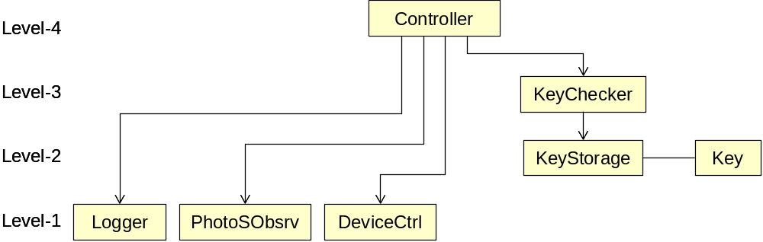
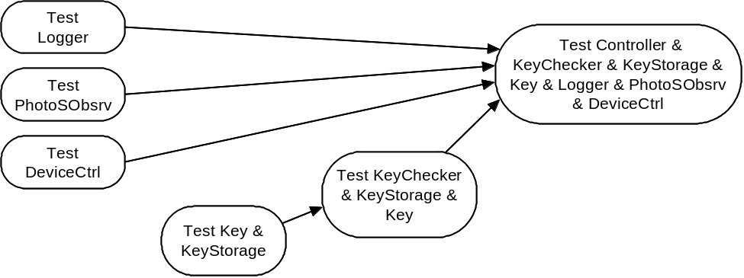
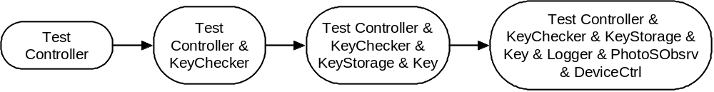
Horizontal Integration Testing
System hierarchy:
Bottom-up integration testing:
Top-down integration testing:

Slide 26
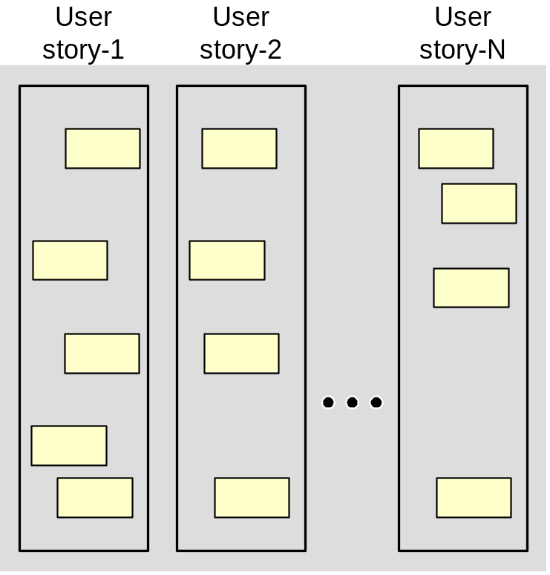
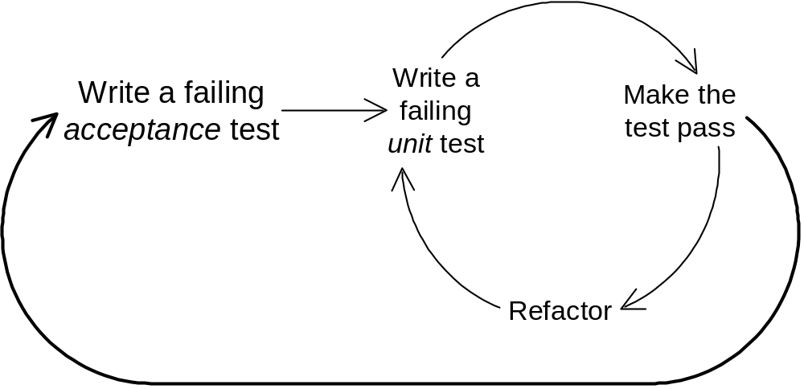
Vertical Integration Testing
inner feedback loop
outer feedback loop
Developing user stories:
Each story is developed in a cycle that integrates unit tests in the inner feedback loop and the acceptance test in the outer feedback loop
Whole system

Slide 27
Logical Organization of Testing
( Not necessarily how it’s actually done! )
Component code
Unit test
Tested component
Component code
Unit test
Integration test
Integrated modules
System test
System in use
Ensures that all components work together
Component code
Unit test
Function test
Quality test
Acceptance test
Installation test
Ensure that each component works as specified
Verifies that functional requirements are satisfied
Verifies non-functional requirements
Customer verifies all requirements
Testing in user environment

Slide 28
System Testing
To test the whole system in our case study of safe home access,
we need to work with a locksmith and electrician to check that the lock and electrical wiring are properly working

